Slide 1
Project on PRODUCTION PLANNING AND CONTROLLING (PPC)
Trainer Name – Lata Verma
Team 09 - Ayushi Jain
Akansha Pal
Tarun Khanna
Karan Khanna

Slide 2
CONTENTS
Introduction
Login Page
Admin Views
User Views
Limitation
Summary
Conclusion
Queries

Slide 3
INTRODUCTION
For efficient, effective and economical operation in a manufacturing unit of an organization, it is essential to integrate the production planning and control system.
Production planning and control address a fundamental problem of low productivity, inventory management and resource utilization.
Production control ensures that production team can achieve required production target, optimum utilization of resources, quality management and cost savings.

Slide 4
Plus Point of our Application :
It’s a GENERAL APPLICATION i.e., It can be employed to any form of Industry.
Name of our Application :
C4 Factory
BUT WHY C4 ????
C4 refers to 4 C’s : - Chocolate , Cake , Cookies , Chips . Just a random industry we chose for easier understanding of our application.

Slide 5
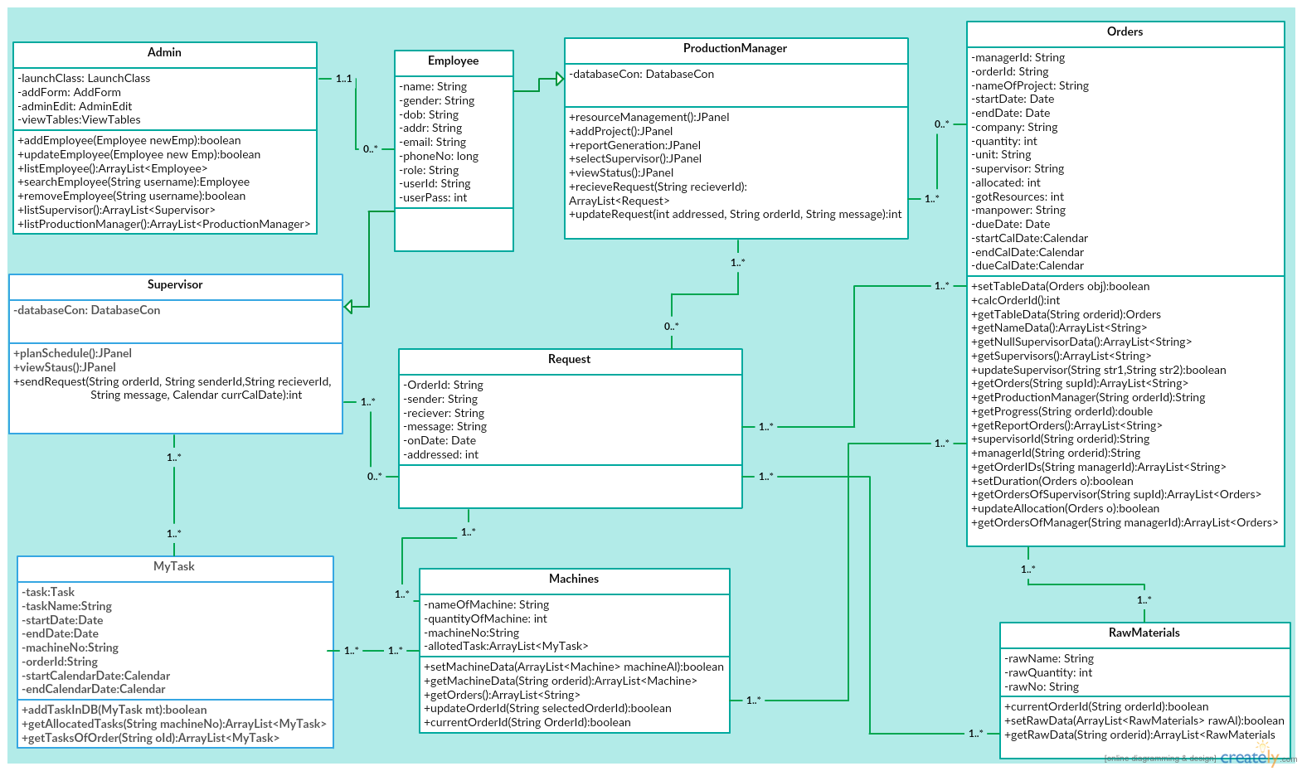
CLASS DIAGRAM

Slide 6
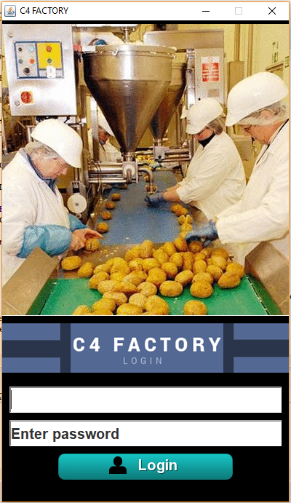
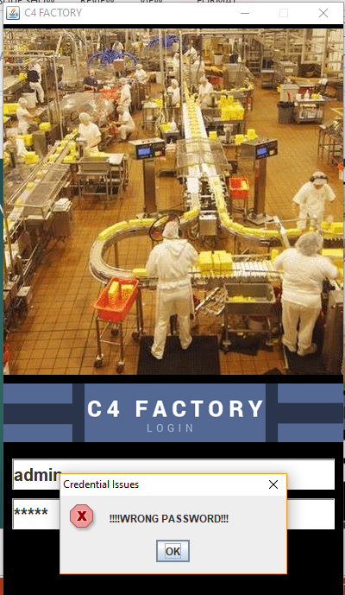
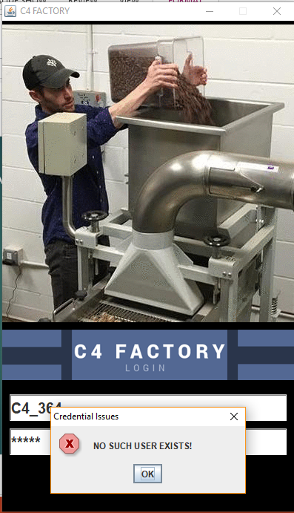
LOGIN FRAME

Slide 7
VIEWS
In this project , Views are divided into three parts : -
ADMIN VIEW
PRODUCTION MANAGER VIEW
SUPERVISOR VIEW
According to login credentials Application will show the respective view that is for user or admin.

Slide 8
ADMINISTRATOR VIEW
When Admin logs-in, admin will redirect to the admin home page where Admin will have different functionalities such as follows:-
ADD NEW PRODUCTION MANAGER / SUPERVISOR
UPDATE/DELETE PRODUCTION MANAGER / SUPERVISOR
VIEW REGISTERED PRODUCTION MANAGER / SUPERVISOR
VIEW LOGIN CREDENTIALS OF EVERY USER

Slide 9
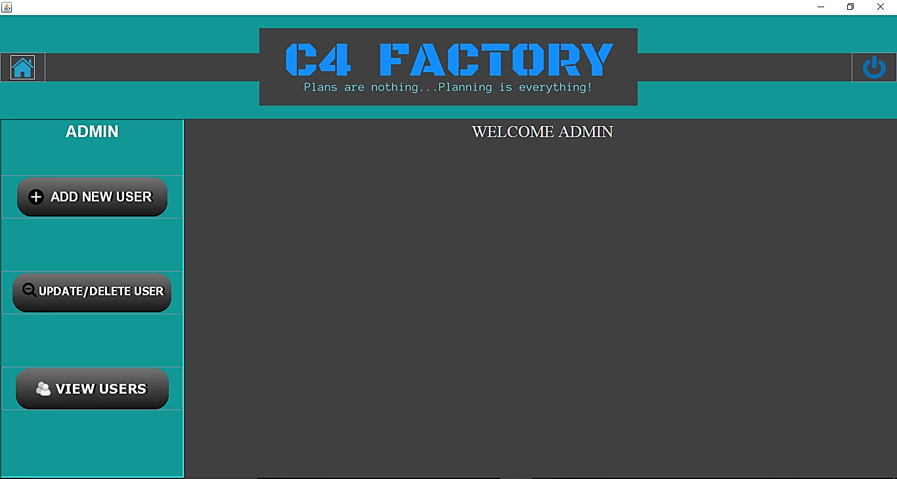
ADMIN FRAME

Slide 10
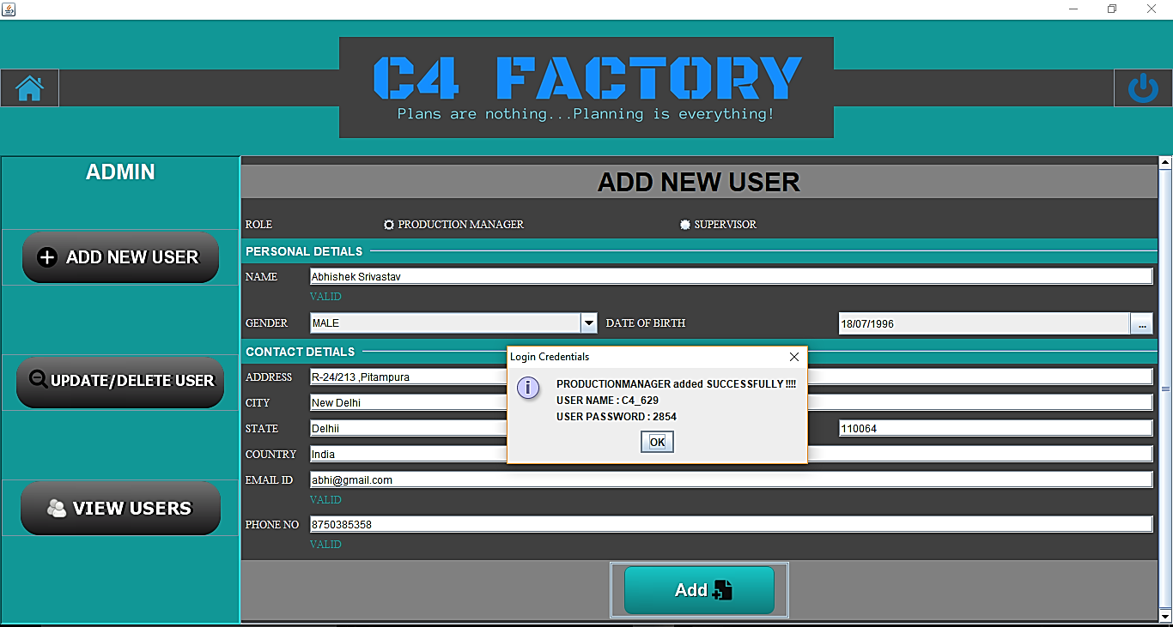
ADD NEW PRODUCTION MANAGER
Random and unique USERNAME AND PASSWORD
With REAL-TIME
Data validation

Slide 11
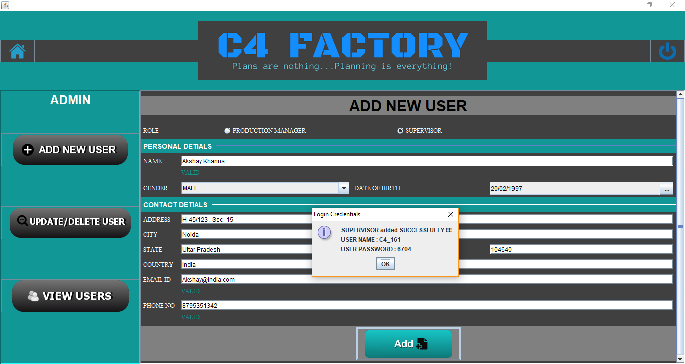
ADD NEW SUPERVISOR
Random and unique USERNAME AND PASSWORD
With REAL-TIME
Data validation

Slide 12
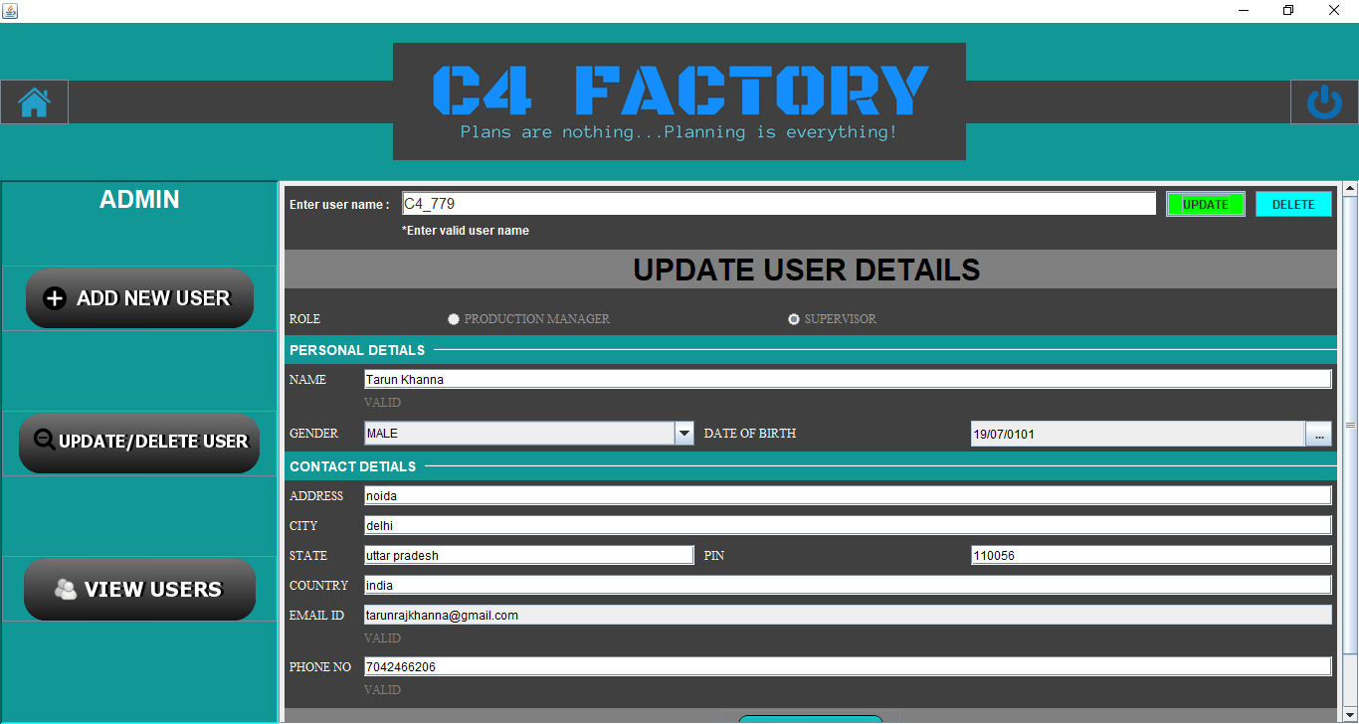
UPDATE USER RECORD

Slide 13
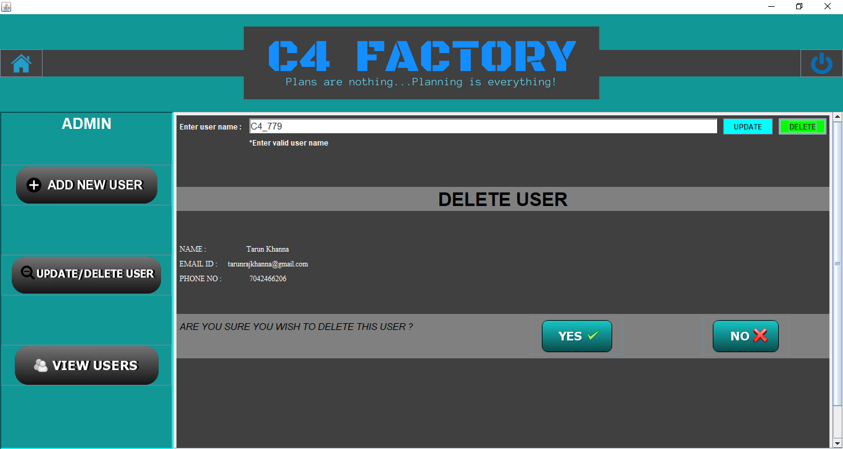
DELETE USER RECORD

Slide 14
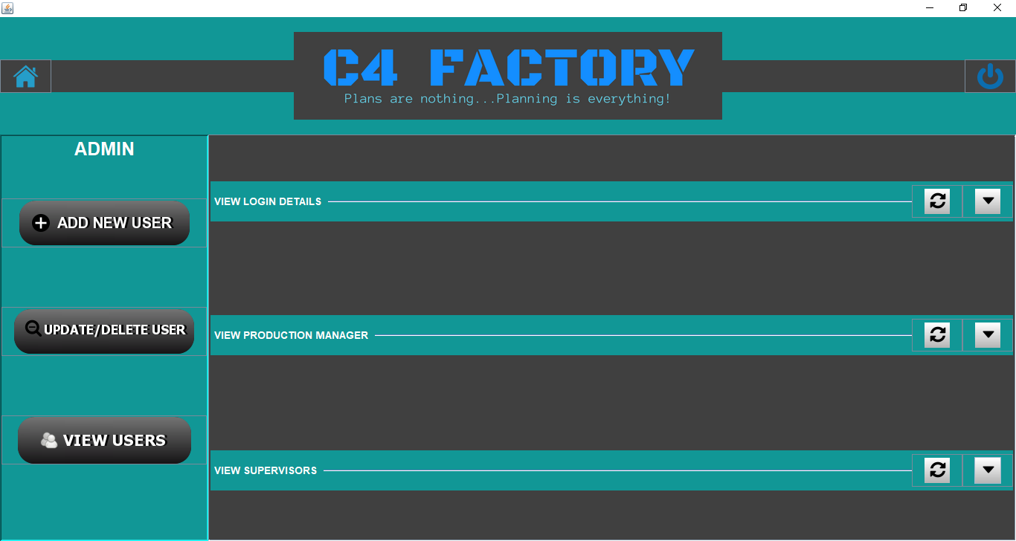
VIEW PANEL
Maximize the View on your choice

Slide 15
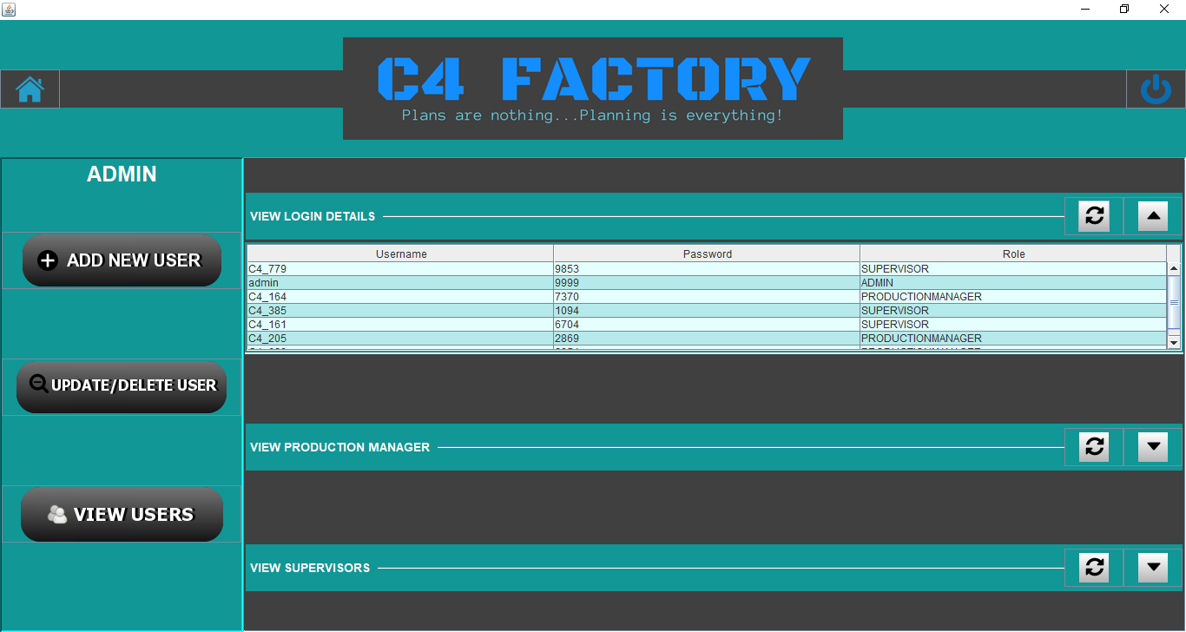
VIEW LOGIN CREDENTIALS

Slide 16
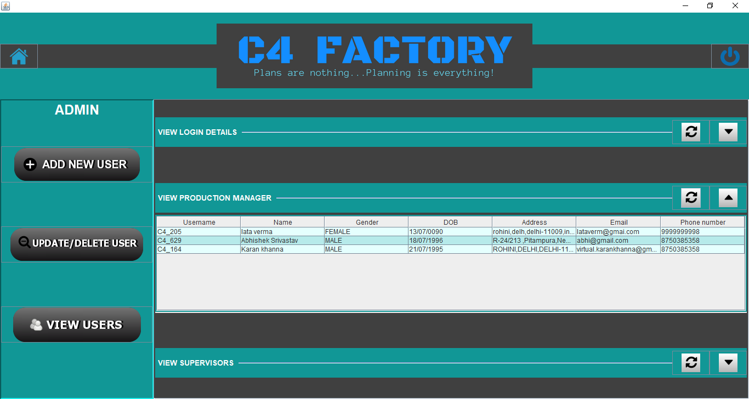
VIEW PRODUCTION MANAGERS

Slide 17
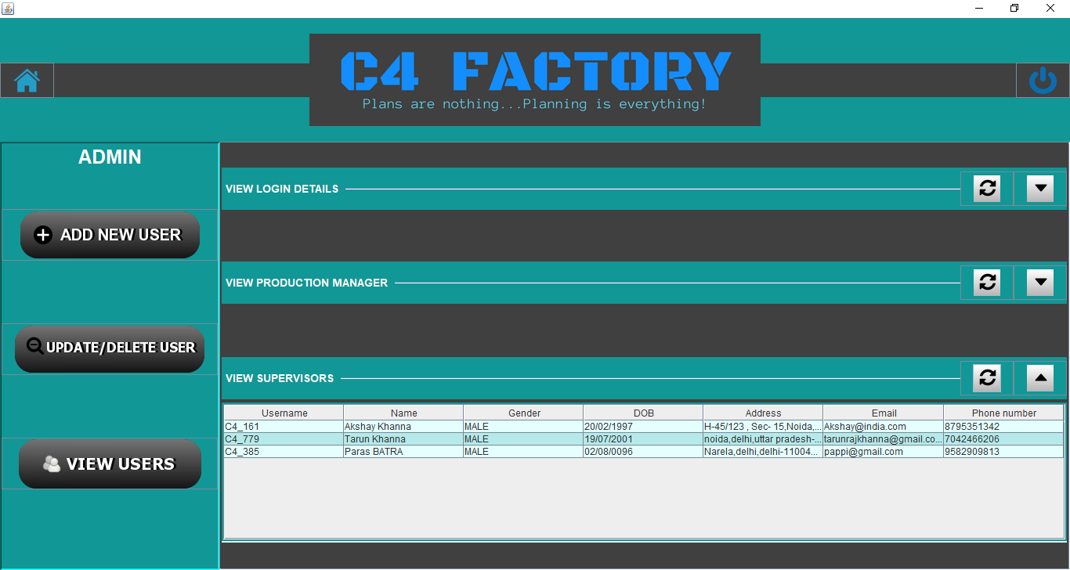
VIEW SUPERVISORS

Slide 18
PRODUCTION MANAGER VIEW
When Production Manager logs-in, he/she will redirect to the manager home page where manager will have different functionalities such as follows:-
ADD NEW PROJECT
VIEW EXISTING PROJECTS AND THEIR PROGRESS
ALLOCATE RESOURCES TO A PROJECT (Machines and Raw Materials)
ASSIGN SUPERVISOR TO THE PROJECTS
MONITOR STATUS OF PROJECTS UNDER HIM (DAILY AND MONTHLY)
RESPOND TO SUPERVISOR’S REQUESTS
GENERATE PROJECT REPORT

Slide 19
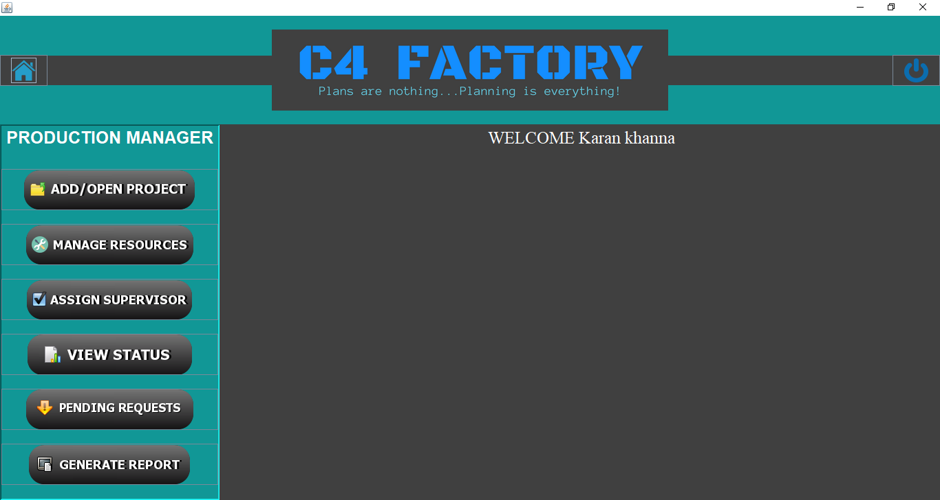
PRODUCTION MANAGER FRAME
Production Manager

Slide 20
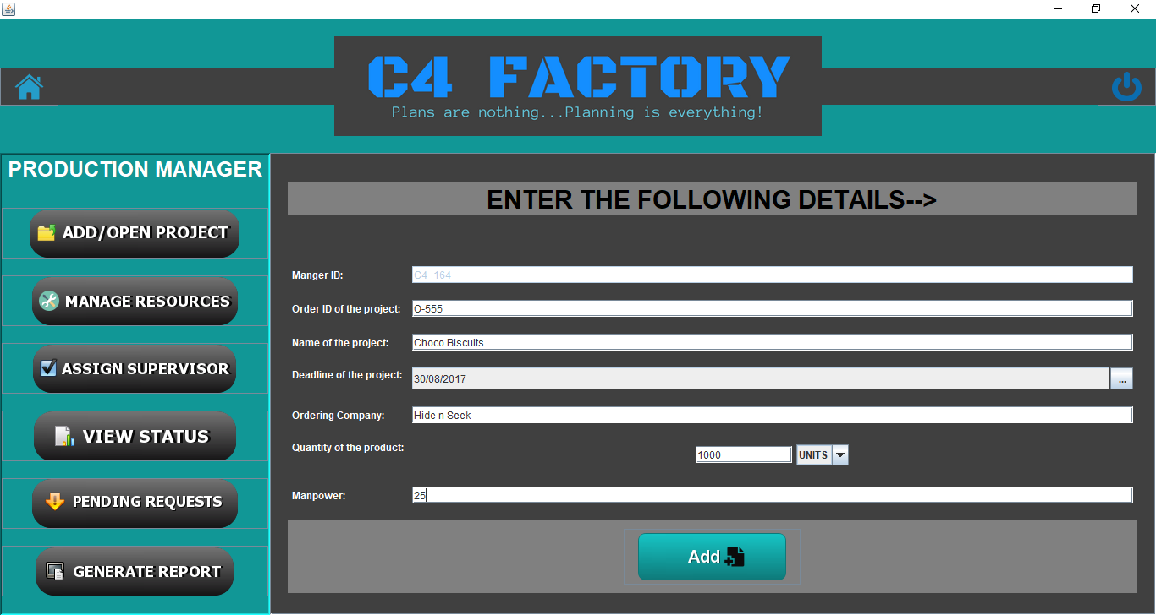
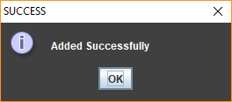
ADD A NEW PROJECT / PRODUCT

Slide 21
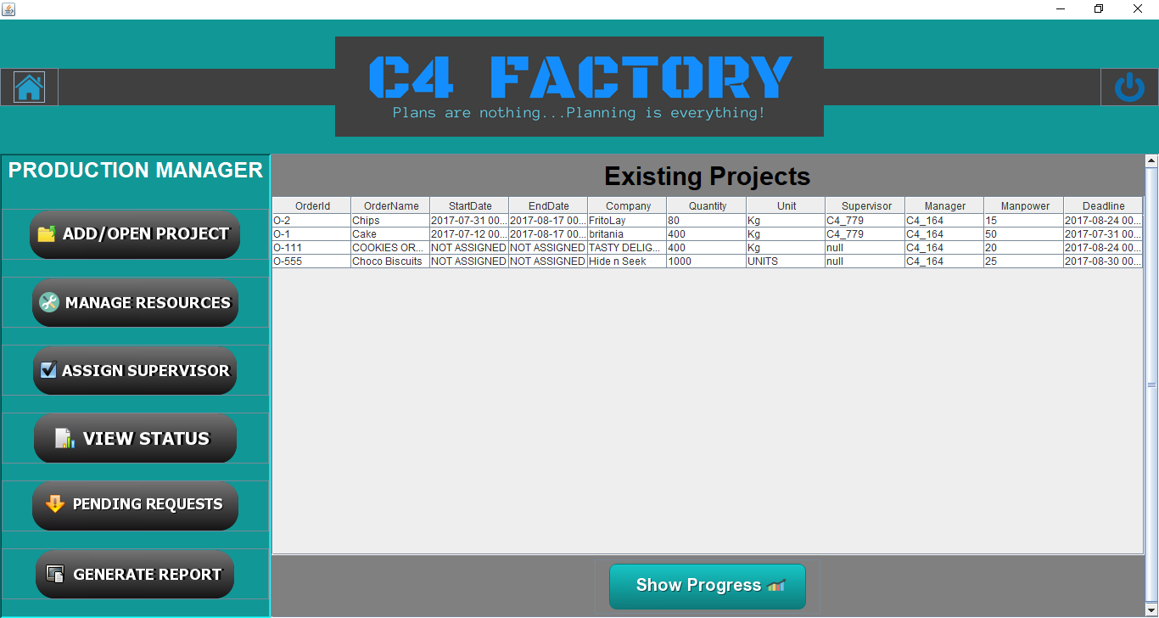
VIEW EXISTING PROJECTS
Production Manager

Slide 22
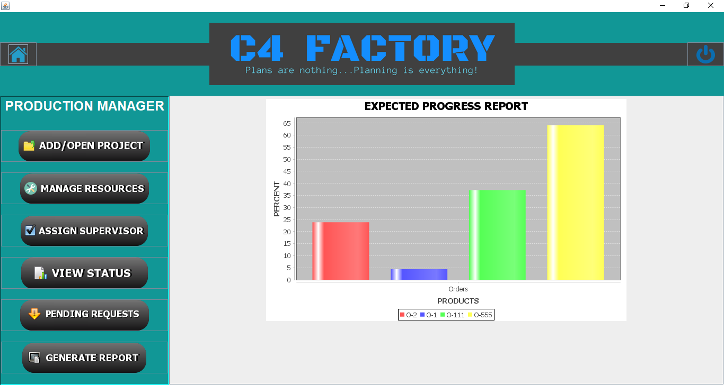
VIEW PROJECTS PROGRESS

Slide 23
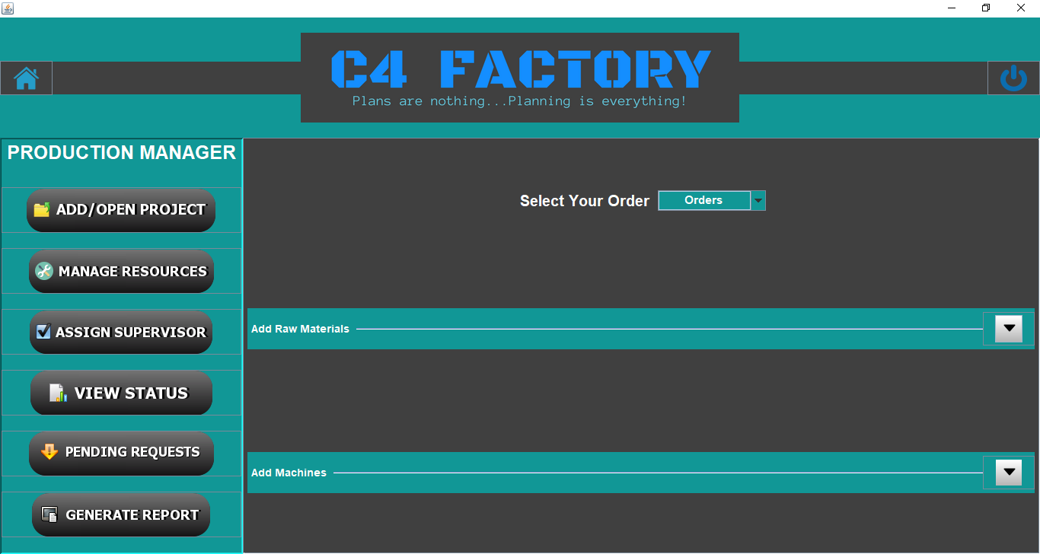
ALLOCATE RESOURCES TO PROJECTS
Production Manager

Slide 24
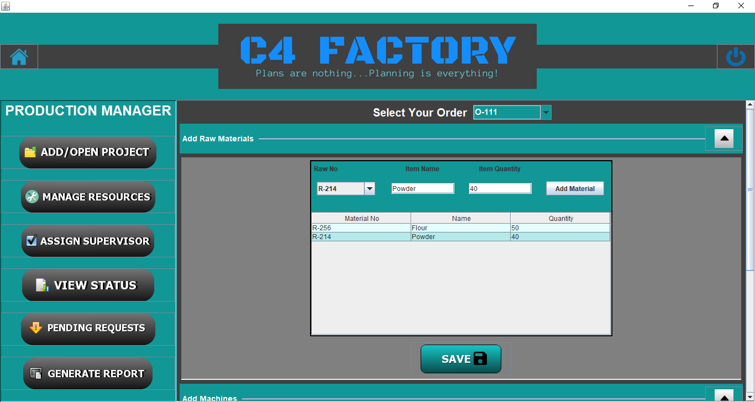
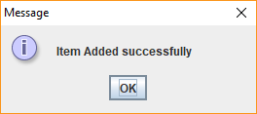
ALLOCATING RAW MATERIALS
Production Manager

Slide 25
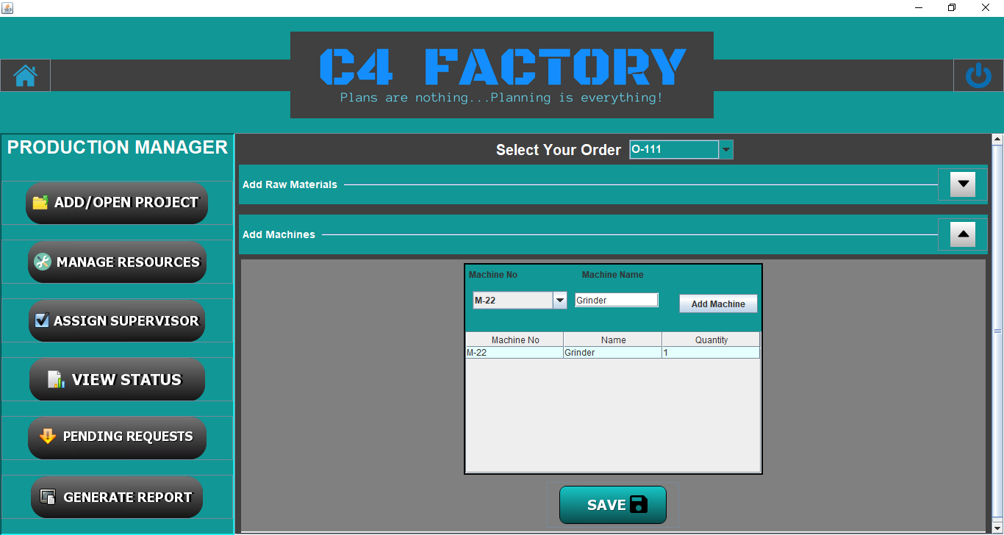
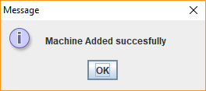
ALLOCATING MACHINES
Production Manager

Slide 26
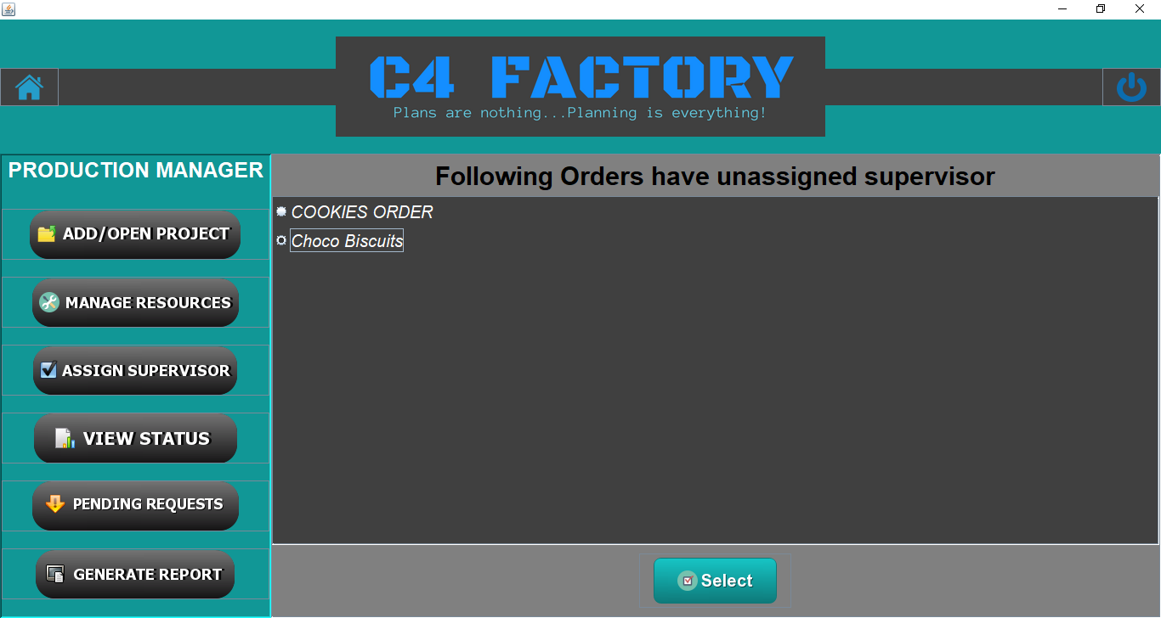
ASSIGN SUPERVISOR TO PROJECT
Production Manager
First Select the order for which you want to assign a supervisor

Slide 27
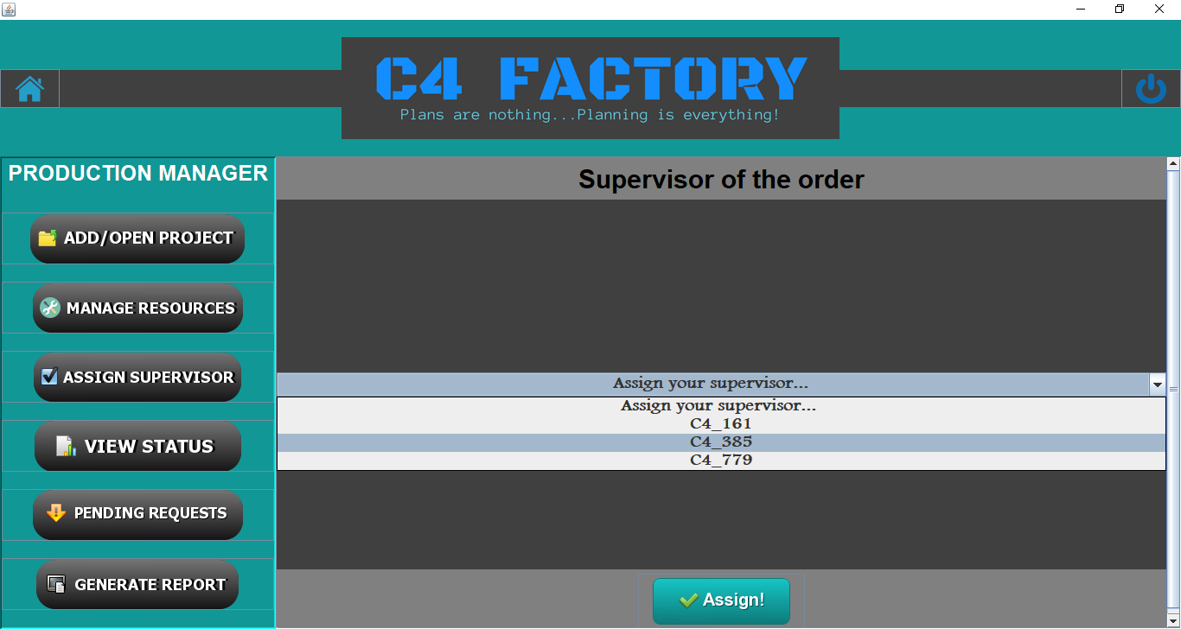
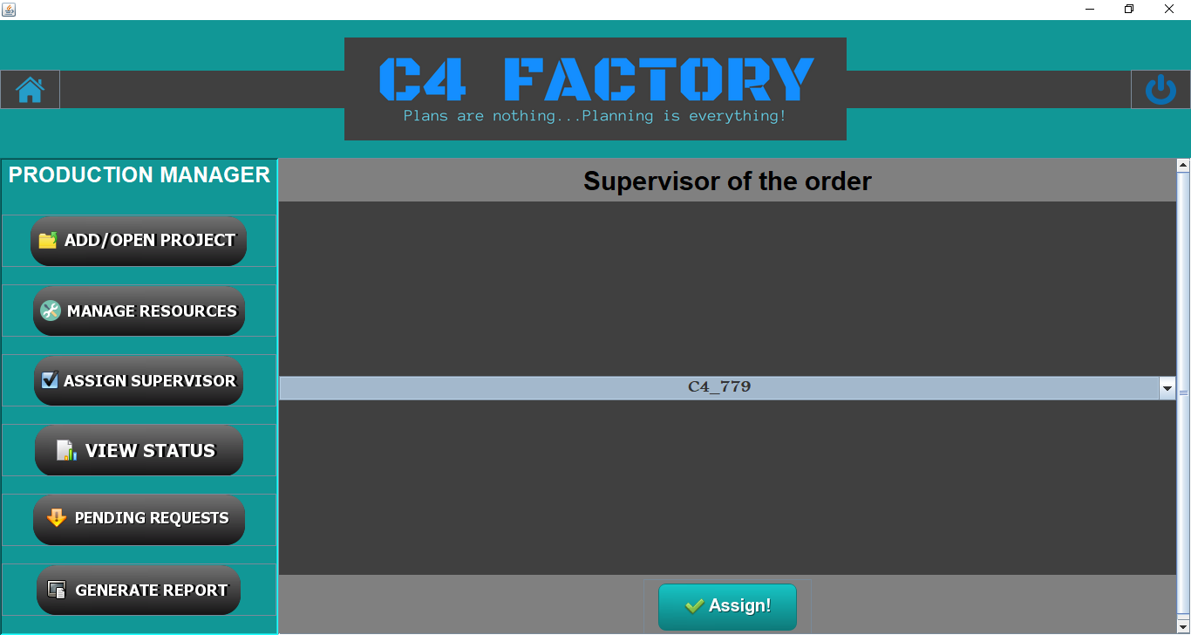
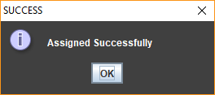
Then choose from the list of existing supervisors.

Slide 28
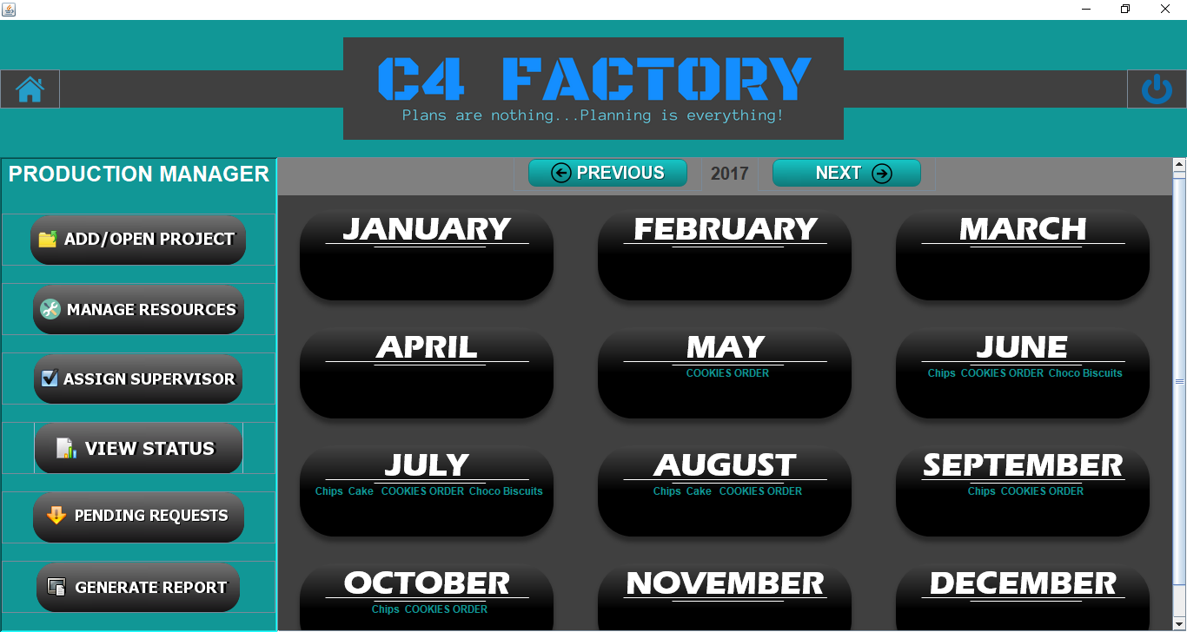
MONITOR PRODUCT STATUS
Production Manager
Click the month to get day-wise view

Slide 29
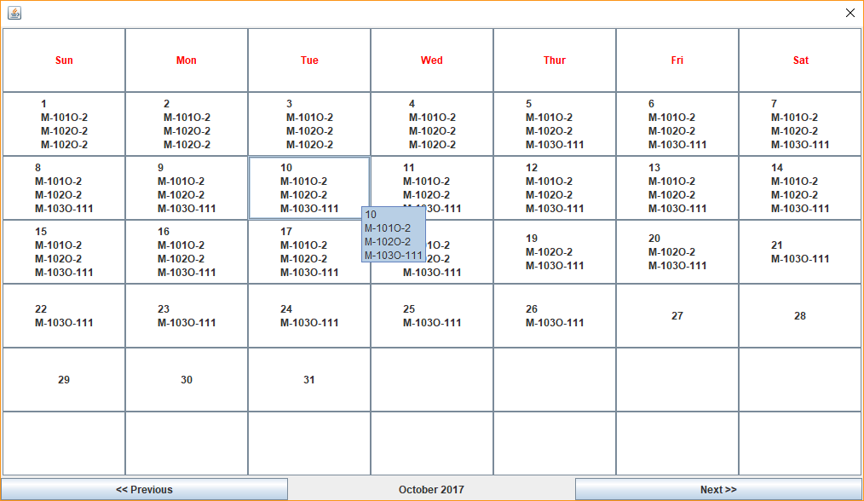
DAY-WISE PRODUCT STATUS
Production Manager

Slide 30
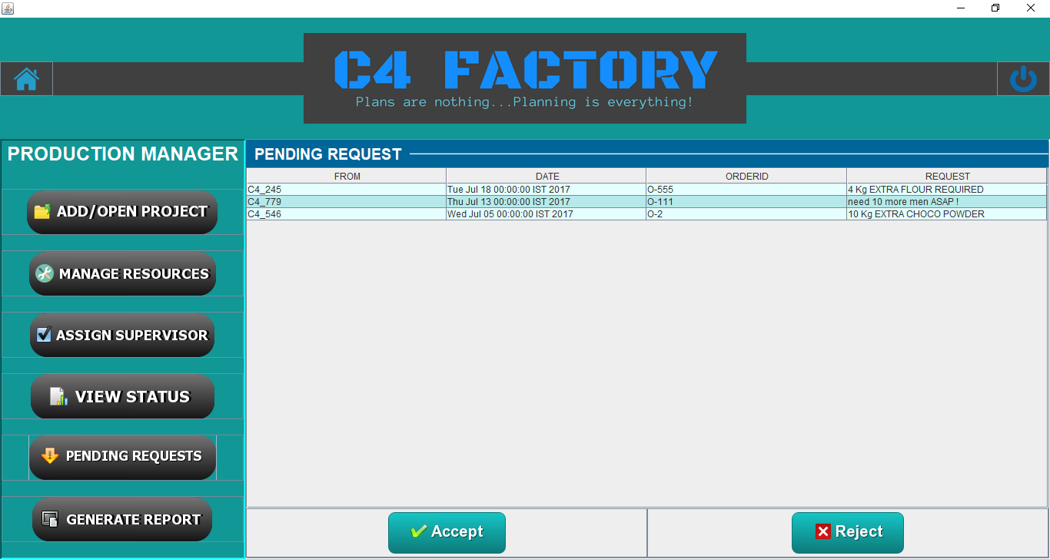
HANDLE REQUESTS FROM SUPERVISORS
Production Manager
Accept or Reject the requests.

Slide 31
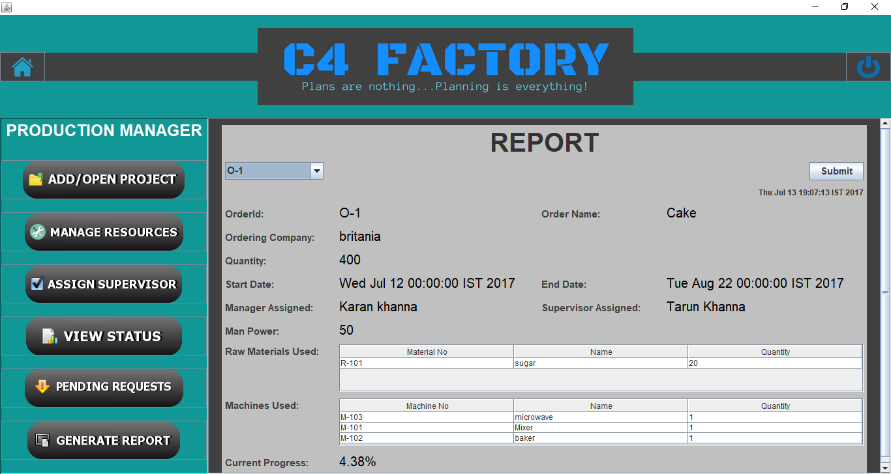
REPORT GENERATION
Production Manager

Slide 32
SUPERVISOR VIEW
When the Supervisor logs-in, he/she will redirect to the Supervisor home page where supervisor will have different functionalities such as follows:-
Planning and Scheduling of orders.
Monitor order status under him (Monthly and Weekly).
Make requests regarding an order to the respective Production Manager.

Slide 33
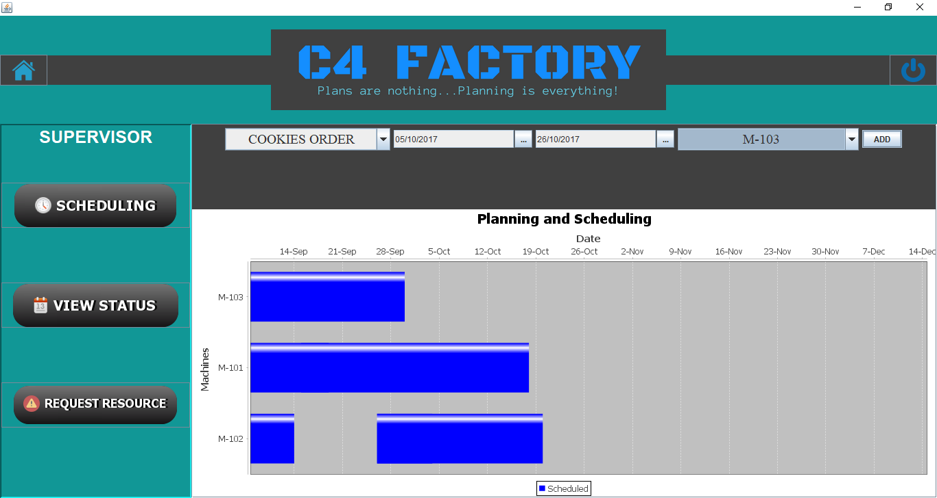
PLANNING AND SCHEDULING
Supervisor
Select start date
Select end date
Select order
Select machine

Slide 34
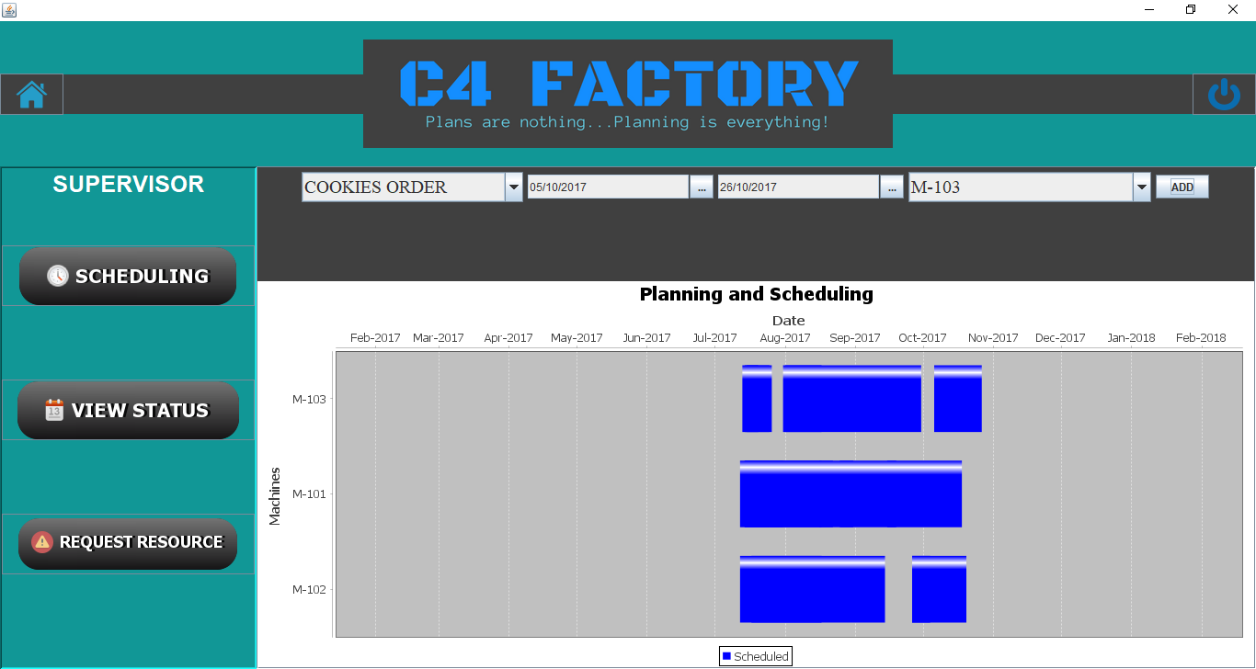
New Task scheduled

Slide 35
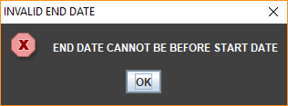
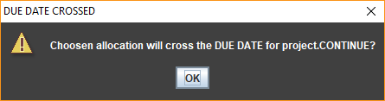
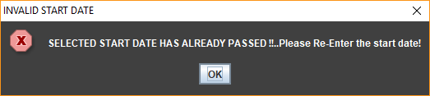
STRICT VALIDATIONS :
Supervisor

Slide 36
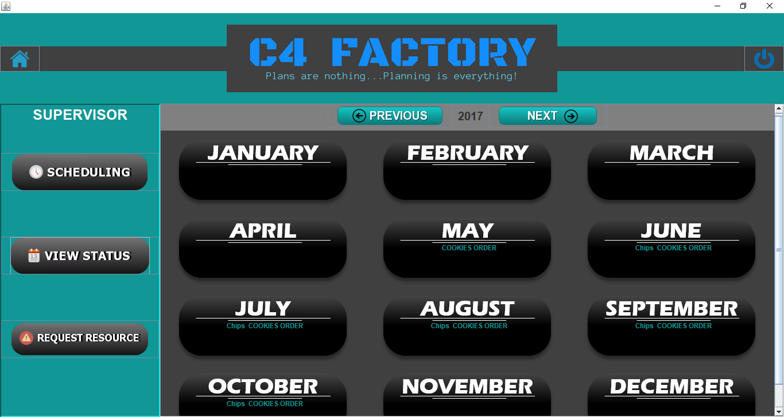
MONITOR PRODUCT STATUS
Supervisor
Click the month to get day-wise view
Only products under this supervisor are displayed

Slide 37
DAY-WISE PRODUCT STATUS
Supervisor

Slide 38
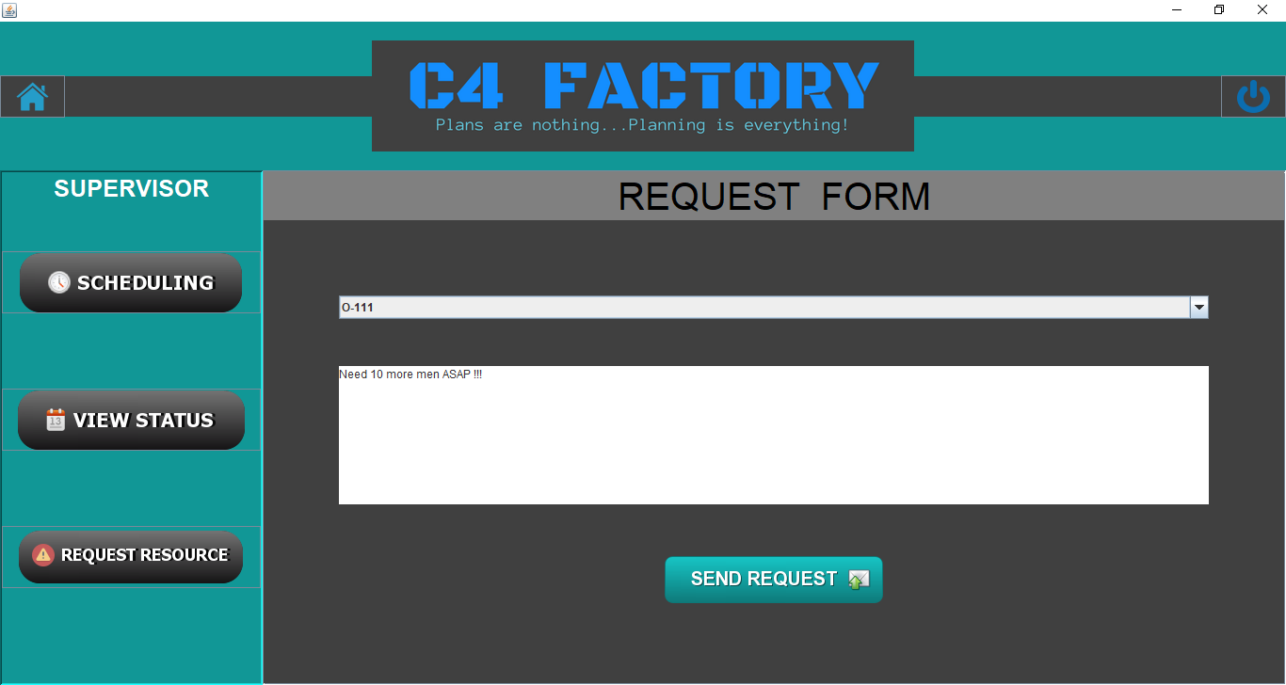
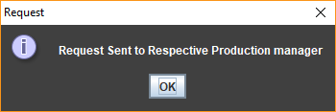
REQUESTING REGARDING AN ORDER
Supervisor

Slide 39
LIMITATIONS
Works on ideal conditions
Doesn’t cover ordering department, sales department or dispatching department.
Doesn’t calculate profit or losses.

Slide 40
SUMMARY
We have done our best to understand the requirement of the user and have put forward all the functionalities so as to develop and design the expected software.
The project meets the user requirements and is built in such a way that it can be updated as per the user demands.
It has been developed using Core Java and Oracle Database.

Slide 41
CONCLUSION
From this training project we conclude that it was a lovely experience working with each other. We have gained concepts which we were un aware of.
We team09 want to thank our trainer “Lata Verma” for giving us an opportunity to work on this project ,and guiding us in all circumstances as well as providing us the knowledge which will be helpful in our future IT carrier.
THANK YOU
AYUSHI JAIN
AKANSHA PAL
TARUN KHANNA
KARAN KHANNA

Slide 42
THANK YOU !

Slide 43
ANY QUERIES
?

